Slide 1
Python Lists
Course Instructor:
Asma Khan

Slide 2
List in python is implemented to store the sequence of various type of data. However, python contains six data types that are capable to store the sequences but the most common and reliable type is list.
A list can be defined as a collection of values or items of different types. The items in the list are separated with the comma (,) and enclosed with the square brackets [].

Slide 3
L1 = ["John", 102, "USA"] L2 = [1, 2, 3, 4, 5, 6] L3 = [1, "Ryan"]
emp = ["John", 102, "USA"]
Dep1 = ["CS",10];
Dep2 = ["IT",11];
HOD_CS = [10,"Mr. Holding"]
HOD_IT = [11, "Mr. Bewon"]
print("printing employee data...");
print("Name : %s, ID: %d, Country: %s"%(emp[0],emp[1],emp[2]))
print("printing departments...");
print("Department 1:\nName: %s, ID: %d\nDepartment 2:\nName: %s, ID: %s"%(Dep1[0],Dep2[1],Dep2[0],Dep2[1]));
print("HOD Details ....");
print("CS HOD Name: %s, Id: %d"%(HOD_CS[1],HOD_CS[0]));
print("IT HOD Name: %s, Id: %d"%(HOD_IT[1],HOD_IT[0]));
print(type(emp),type(Dep1),type(Dep2),type(HOD_CS),type(HOD_IT));

Slide 4
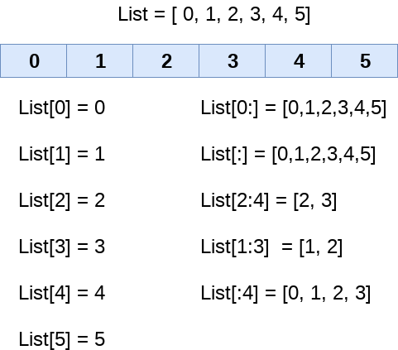
List indexing and splitting The indexing are processed in the same way as it happens with the strings. The elements of the list can be accessed by using the slice operator []. The index starts from 0 and goes to length - 1. The first element of the list is stored at the 0th index, the second element of the list is stored at the 1st index and so on.

Slide 5
Unlike other languages, python provides us the flexibility to use the negative indexing also. The negative indices are counted from the right. The last element (right most) of the list has the index -1, its adjacent left element is present at the index -2 and so on until the left most element is encountered.

Slide 6
Updating List values Lists are the most versatile data structures in python since they are immutable and their values can be updated by using the slice and assignment operator. Python also provide us the append() method which can be used to add values to the string. Consider the following example to update the values inside the list.
[1, 2, 3, 4, 5, 6] [1, 2, 10, 4, 5, 6] [1, 89, 78, 4, 5, 6]
List = [1, 2, 3, 4, 5, 6]
print(List)
List[2] = 10;
print(List)
List[1:3] = [89, 78]
print(List)

Slide 7
Iterating a List A list can be iterated by using a for - in loop. A simple list containing four strings can be iterated as follows.
List = ["John", "David", "James", "Jonathan"]
for i in List:
print(i);
Python provides append() function by using which we can add an element to the list. However, the append() method can only add the value to the end of the list.
l =[];
n = int(input("Enter the number of elements in the list")); #Number of elements will be entered by the user
for i in range(0,n): # for loop to take the input
l.append(input("Enter the item?")); # The input is taken from the user and added to the list as the item
print("printing the list items....");
for i in l: # traversal loop to print the list items
print(i, end = " ");

Slide 8
Removing a List item
List = [0,1,2,3,4]
print("printing original list: ");
for i in List:
print(i,end=" ")
List.remove(0)
print("\nprinting the list after the removal of first element...")
for i in List:
print(i,end=" ")

Slide 9
Built in Functions
SN | Function | Description
1 | cmp(list1, list2) | It compares the elements of both the lists.
2 | len(list) | It is used to calculate the length of the list.
3 | max(list) | It returns the maximum element of the list.
4 | min(list) | It returns the minimum element of the list.
5 | list(seq) | It converts any sequence to the list.

Slide 10
1 | list.append(obj) | The element represented by the object obj is added to the list.
2 | list.clear() | It removes all the elements from the list.
3 | List.copy() | It returns a shallow copy of the list.
4 | list.count(obj) | It returns the number of occurrences of the specified object in the list.
5 | list.extend(seq) | The sequence represented by the object seq is extended to the list.
6 | list.index(obj) | It returns the lowest index in the list that object appears.
7 | list.insert(index, obj) | The object is inserted into the list at the specified index.
8 | list.pop(obj=list[-1]) | It removes and returns the last object of the list.
9 | list.remove(obj) | It removes the specified object from the list.
10 | list.reverse() | It reverses the list.
11 | list.sort([func]) | It sorts the list by using the specified compare function if given.

